Slide 1
Computer Architecture:
Exceptions & Interrupts
Part 2: Atomics, Nesting, and Faults
Dr. Colin O’Flynn

Slide 2
Lectures
How does a program run on a machine?
How do you compile from high-level code to machine code?
How do you observe the machine running?
How do we define the machine?
How does the machine control flow change (planned)?
How does the machine control flow change (unplanned)?
How does the machine control flow change (chaotic unplanned)?

Slide 3
Part 2-1: Atomic Operations

Slide 4
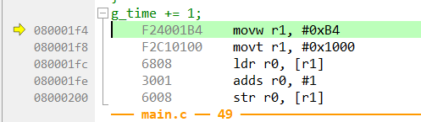
Interrupting Work
counter++;

Slide 5
Race Condition
Main Function
Interrupt
Variable in memory

Slide 6
Introducing Atomic Operations
An atomic operation is one which is guaranteed to complete without interruption
The previous example of a load, increment, store is a classic example of something which may require an atomic operation

Slide 7
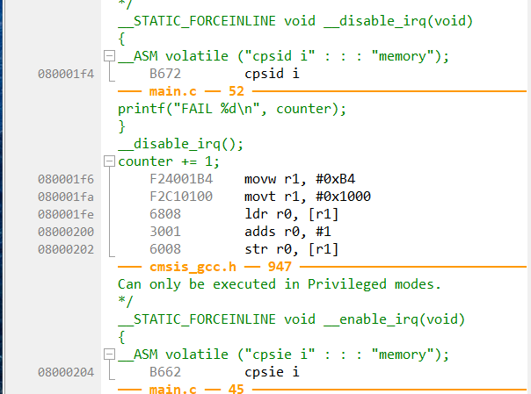
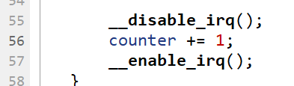
Solution #1: No Interrupts!

Slide 8
Arm CPSID / CPSIE
CPSID = Change Processor State - Interrupt Disable
CPSIE = Change Processor State - Interrupt Enable
i = configurable interrupts (NMI, Faults still enabled)
f = faults (to be discussed)

Slide 9
Solution #2: Arm Exclusive Access
Load value + mark “exclusive”
Attempt store
Store succeeds only if no interference occurred
If Interference:
Store fails
Software retries
int atomic_inc(int *p) {
int old, status;
do {
old = __LDREXW(p);
status = __STREXW(old + 1, p);
} while (status != 0);
return old + 1;
}

Slide 10
Exclusive Access vs. Disabling Interrupts
Disabling interrupts can be a risk in a system with time-critical operations
Global interrupt disabling can be very impactful on a complex system
Exclusive access avoids these problems

Slide 11
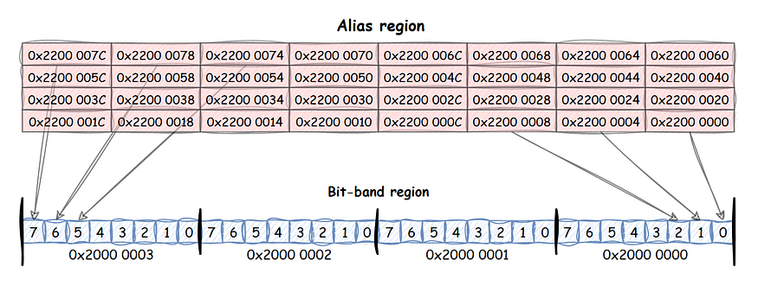
Solution #3: Bit-Banding
https://medium.com/@levinet.nicolai/bit-banding-in-arm-cortex-m-a-brilliant-feature-but-why-was-it-abandoned-139f7ed04685

Slide 12
Bit Banding
Each word represents a single bit - this allows writes & clears to affect only one bit
This is different from devices which often offer a “set” and “clear” bit register (which is more efficient)

Slide 13
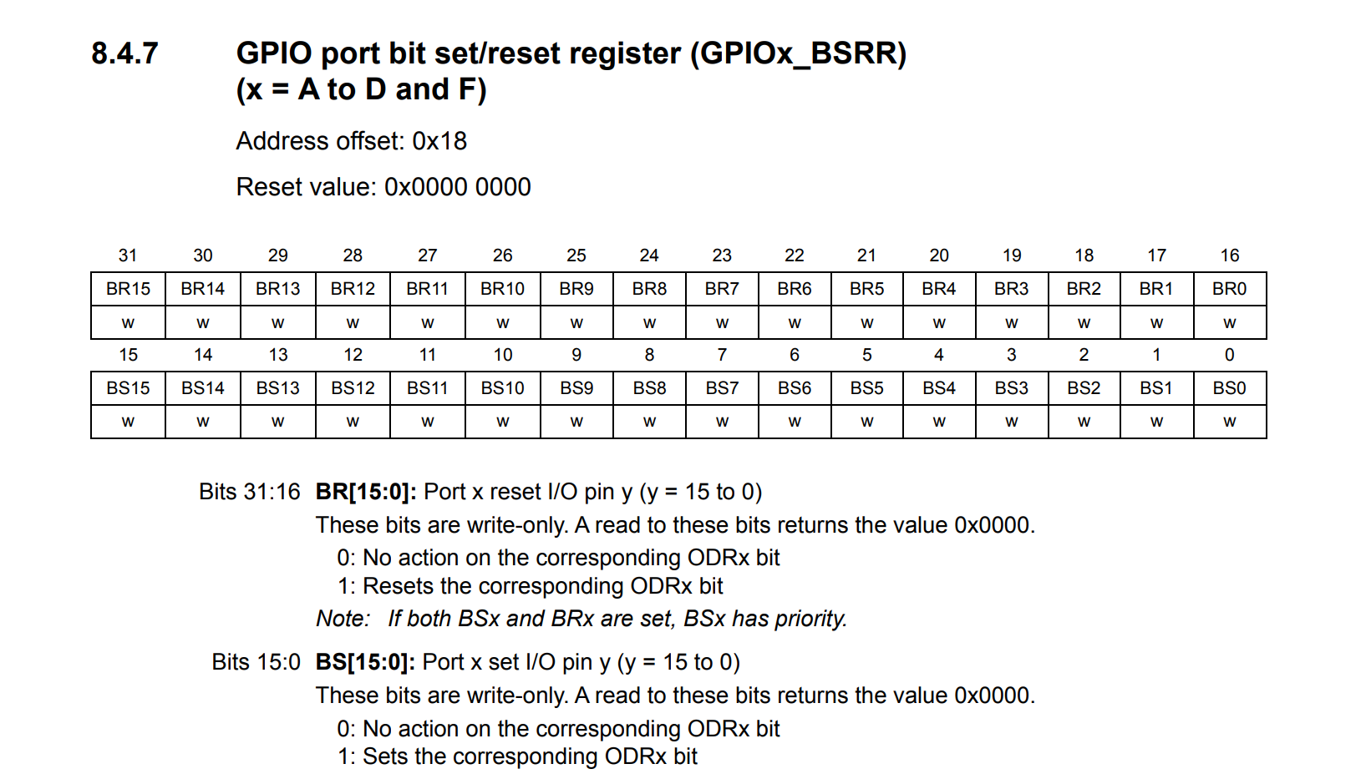
Solution #4: Set / Clear Registers (Peripherals Only)

Slide 14
Reminder on bit set/clear in registers
With registers we can set or clear bits directly
Remember as Arm is load-store architecture we always have load and store when dealing with memory
Atomic operations are normally referencing atomic operations on memory

Slide 15
Atomic Operation Summary
If disabling interrupts, keep this very short
  Watch out for function calls would normally avoid! And other things that “could” be slow
Difficult to debug problems with this as debugging may change timing
Atomic operations can be needed inside of interrupts if we can nest….

Slide 16
Part 2-2: Nesting

Slide 17
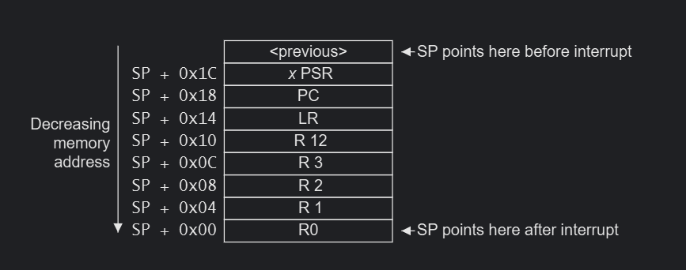
Reminder: Exception Entry / Returns

Slide 18
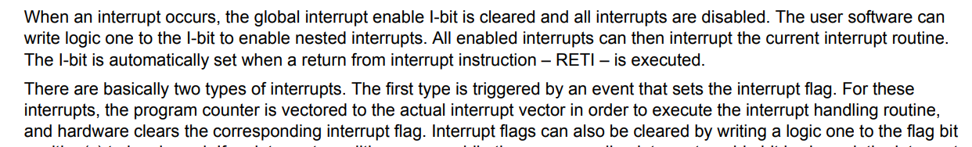
Endless Interrupt Risks
Interrupts which re-occur too quickly have a risk of overloading a system.
Some architectures such as AVR disable global interrupts initially, letting the user decide to re-enable them:

Slide 19
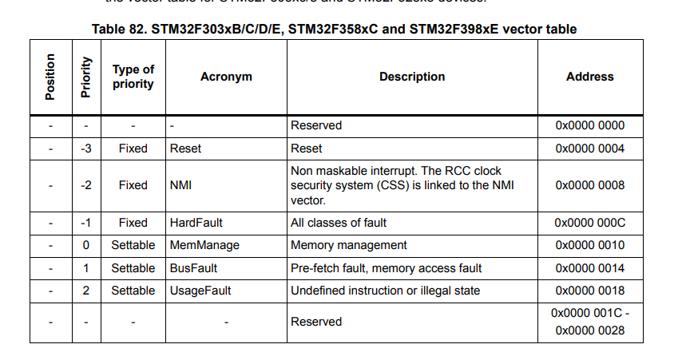
Exception Priorities
Most interrupts have a changeable priority
Remember lower number = higher priority
Set priority based on:
  Interrupt handler speed (short code can have higher priority)
  System requirements
  Interrupt frequency

Slide 20
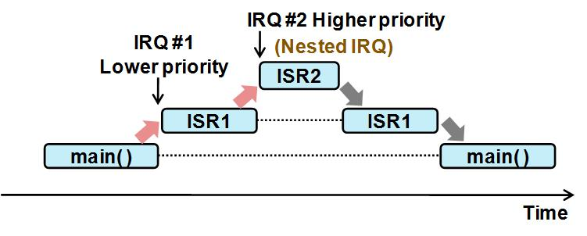
Higher Priority Interrupts

Slide 21
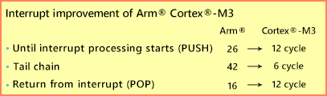
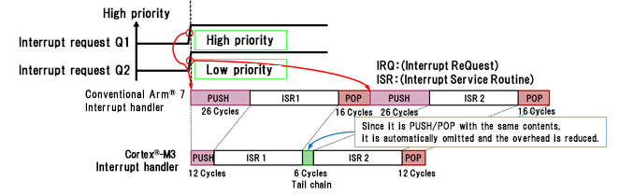
Lower Priority Interrupts & Tail Chaining
A lower priority interrupt that occurs during a higher priority interrupt will start executing at the end of the interrupt.

Slide 22
Lower Priority Interrupts & Tail Chaining
A lower priority interrupt that occurs during a higher priority interrupt will start executing at the end of the interrupt.

Slide 23
Part 2-3: Faults

Slide 24
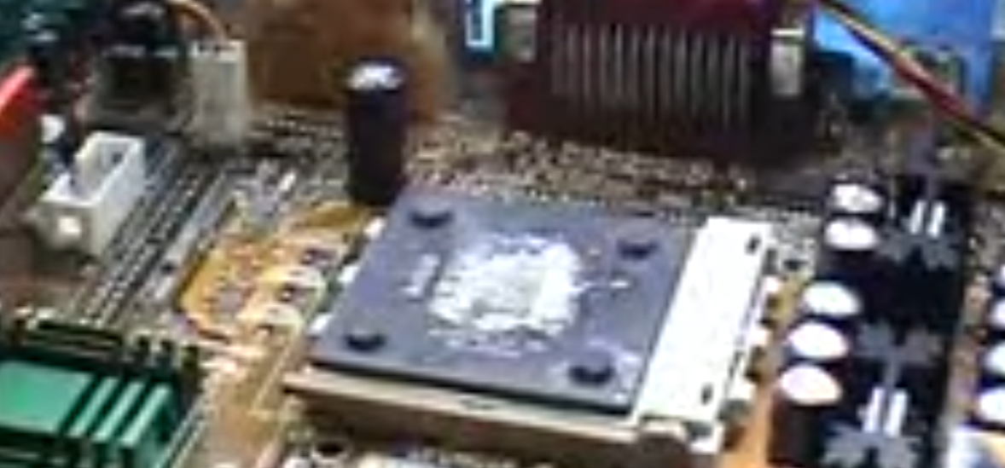
Faults
CPU Needs to deal with issues such as:
  Invalid instructions
  Accessing memory that doesn’t exist
  Conflicts on the bus

Slide 25
Faults vs. Aborts
Exception: any hardware-initiated control transfer
Interrupt: asynchronous exception
Fault: exception caused by illegal execution
Abort: fault related to memory access

Slide 26
Cortex-M Faults
HardFault (catch-all)
Memory faults
Bus faults
Usage faults

Slide 27
Hard Fault: The Safety Net
HardFault occurs when:
A fault is not handled
Multiple faults happen simultaneously
System is in an unrecoverable state

Slide 28
Memory Faults: Illegal Access
Memory faults occur when:
Accessing unmapped memory
Violating memory protection
Accessing forbidden regions
General Ideal: Not all addresses are valid memory.

Slide 29
Bus Faults: Access Failed Mid-Flight
Bus faults occur when:
Address is valid
Memory system fails
Peripheral error
Bus timeout
External memory failure
General Idea: Address was mapped correctly but some other error

Slide 30
Usage Fault
Usage faults occur when:
Invalid instruction encoding
Undefined instruction
Divide by zero (optional)
Unaligned access (optional)
General Ideal: CPU cannot execute meaningless instruction

Slide 31

HardFault Handler
What do we do when a HardFault occurs?

Slide 32
Remember The Exception Stack

Slide 33
Stack Inspection Saves Us
The above registers were pushed onto the stack at the moment of the exception.
We can analyze the exception to understand what was on the stack at that moment in time.

Slide 34
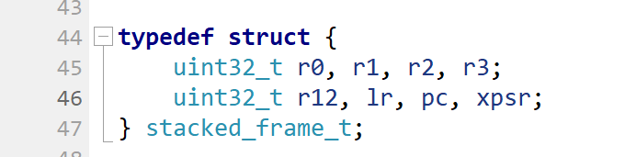
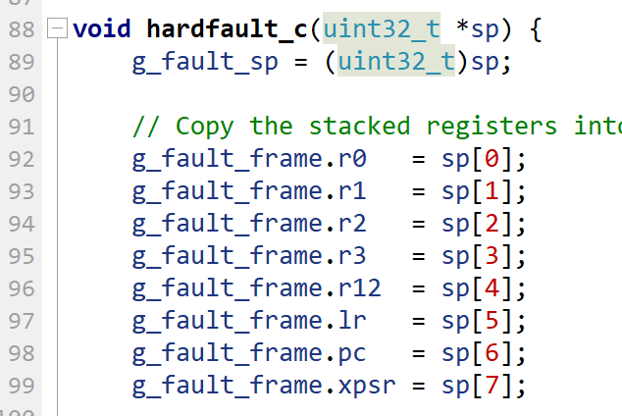

Slide 35
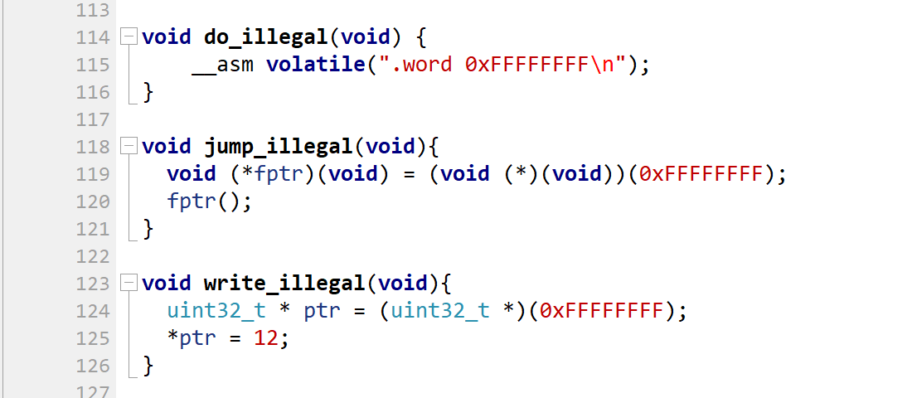
Demo: Triggering Faults

Slide 36
More information on registers
Several other registers we can inspect – see:
https://developer.arm.com/documentation/107706/0100/System-exceptions/Fault-exceptions-and-their-causes

Slide 37
Summary
Interrupts & Exceptions can introduce race conditions
Using atomic access in sections where we cannot have interrupts is important
Most architectures have some form of interrupt priority
  Implementation details vary
Faults are an exception used for hard errors
The HardFault handler on Arm provides considerable additional detail to help you debug.

